Slide 1

Chapter 7:
Arrays

Slide 2
7.1
Arrays Hold Multiple Values

Slide 3

Arrays Hold Multiple Values
Array: variable that can store multiple values of the same type
Values are stored in adjacent memory locations
Declared using [] operator:
  int tests[5];

Slide 4
Array - Memory Layout
The definition:
  int tests[5];
allocates the following memory:
first element | second element | third element | fourth element | fifth element

Slide 5
Array Terminology
In the definition int tests[5];
int is the data type of the array elements
tests is the name of the array
5, in [5], is the size declarator. It shows the number of elements in the array.
The size of an array is (number of elements) * (size of each element)

Slide 6
Array Terminology
The size of an array is:
  the total number of bytes allocated for it
  (number of elements) * (number of bytes for each element)
Examples:
  int tests[5] is an array of 20 bytes, assuming 4 bytes for an int
  long double measures[10]is an array of 80 bytes, assuming 8 bytes for a long double

Slide 7
Size Declarators
Named constants are commonly used as size declarators.
const int SIZE = 5;
int tests[SIZE];
This eases program maintenance when the size of the array needs to be changed.

Slide 8
7.2
Accessing Array Elements

Slide 9
Accessing Array Elements
Each element in an array is assigned a unique subscript.
Subscripts start at 0
subscripts:
0 | 1 | 2 | 3 | 4

Slide 10
Accessing Array Elements
The last element’s subscript is n-1 where n is the number of elements in the array.
subscripts:
0 | 1 | 2 | 3 | 4

Slide 11
Accessing Array Elements
Array elements can be used as regular variables:
  tests[0] = 79;
  cout << tests[0];
  cin >> tests[1];
  tests[4] = tests[0] + tests[1];
Arrays must be accessed via individual elements:
  cout << tests; // not legal

Slide 12
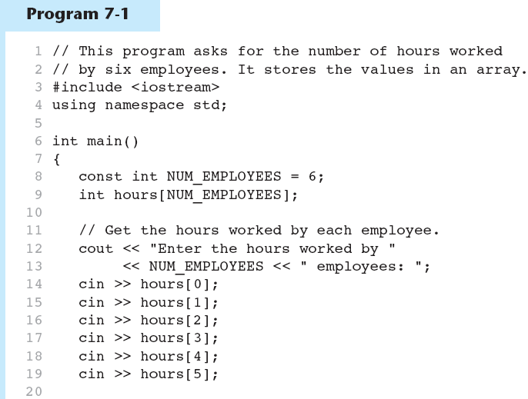
Accessing Array Elements in Program 7-1
(Program Continues)

Slide 13
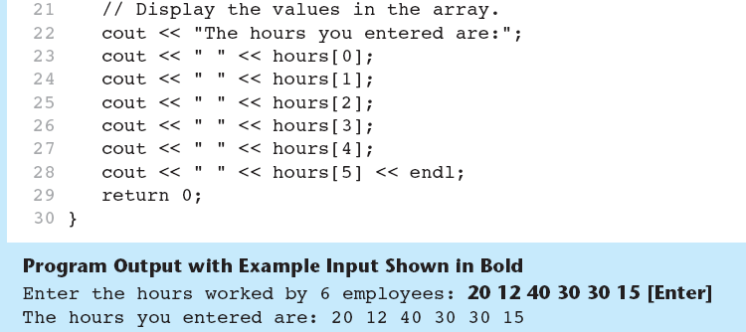
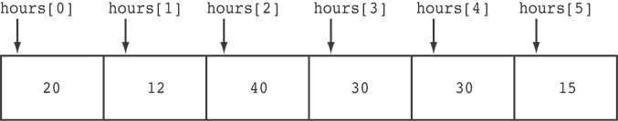
Accessing Array Elements in Program 7-1
Here are the contents of the hours array, with the values entered by the user in the example output:

Slide 14
Accessing Array Contents
Can access element with a constant or literal subscript:
  cout << tests[3] << endl;
Can use integer expression as subscript:
  int i = 5;
  cout << tests[i] << endl;

Slide 15
Using a Loop to Step Through an Array
Example – The following code defines an array, numbers, and assigns 99 to each element:
const int ARRAY_SIZE = 5;
int numbers[ARRAY_SIZE];
for (int count = 0; count < ARRAY_SIZE; count++)
numbers[count] = 99;

Slide 16
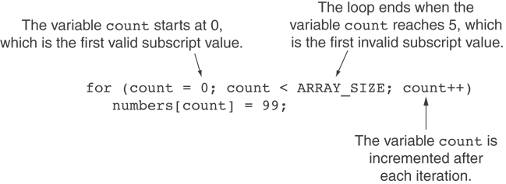
A Closer Look At the Loop

Slide 17
Default Initialization
Global array → all elements initialized to 0 by default
Local array → all elements uninitialized by default

Slide 18
7.3
No Bounds Checking in C++

Slide 19
No Bounds Checking in C++
When you use a value as an array subscript, C++ does not check it to make sure it is a valid subscript.
In other words, you can use subscripts that are beyond the bounds of the array.

Slide 20
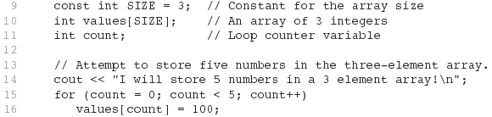
Code From Program 7-5
The following code defines a three-element array, and then writes five values to it!

Slide 21
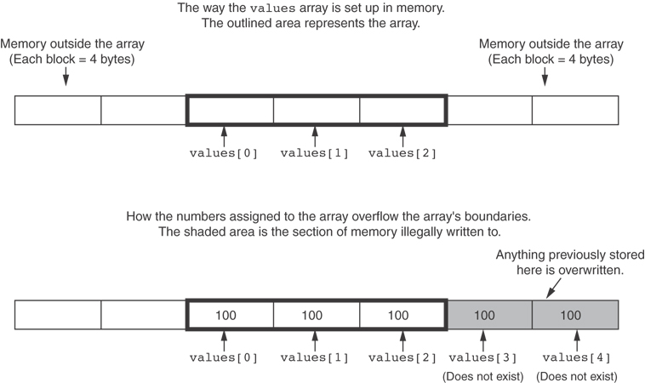
What the Code Does

Slide 22
No Bounds Checking in C++
Be careful not to use invalid subscripts.
Doing so can corrupt other memory locations, crash program, or lock up computer, and cause elusive bugs.

Slide 23
Off-By-One Errors
An off-by-one error happens when you use array subscripts that are off by one.
This can happen when you start subscripts at 1 rather than 0:
// This code has an off-by-one error.
const int SIZE = 100;
int numbers[SIZE];
for (int count = 1; count <= SIZE; count++)
numbers[count] = 0;

Slide 24
7.4
Array Initialization

Slide 25
Array Initialization
Arrays can be initialized with an initialization list:
const int SIZE = 5;
int tests[SIZE] = {79,82,91,77,84};
The values are stored in the array in the order in which they appear in the list.
The initialization list cannot exceed the array size.

Slide 26
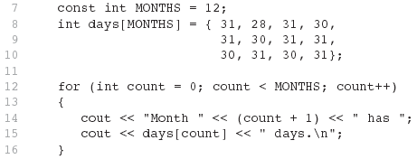
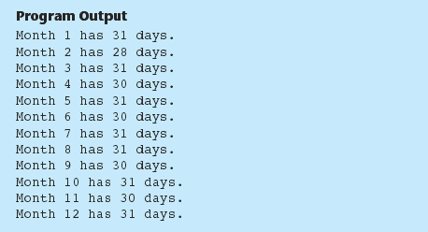
Code From Program 7-6

Slide 27
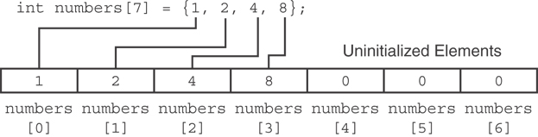
Partial Array Initialization
If array is initialized with fewer initial values than the size declarator, the remaining elements will be set to 0:

Slide 28
Implicit Array Sizing
Can determine array size by the size of the initialization list:
  int quizzes[]={12,17,15,11};
Must use either array size declarator or initialization list at array definition
12 | 17 | 15 | 11

Slide 29
7.6
Processing Array Contents

Slide 30
Processing Array Contents
Array elements can be treated as ordinary variables of the same type as the array
When using ++, -- operators, don’t confuse the element with the subscript:
  tests[i]++; // add 1 to tests[i]
  tests[i++]; // increment i, no
  // effect on tests

Slide 31
Array Assignment
To copy one array to another,
Don’t try to assign one array to the other:
  newTests = tests; // Won't work
Instead, assign element-by-element:
  for (i = 0; i < ARRAY_SIZE; i++)
  newTests[i] = tests[i];

Slide 32
Printing the Contents of an Array
You can display the contents of a character array by sending its name to cout:
char fName[] = "Henry";
  cout << fName << endl;
  But, this ONLY works with character arrays!

Slide 33
Printing the Contents of an Array
For other types of arrays, you must print element-by-element:
  for (i = 0; i < ARRAY_SIZE; i++)
  cout << tests[i] << endl;

Slide 34
Printing the Contents of an Array
In C++ 11 you can use the range-based for loop to display an array's contents, as shown here:
for (int val : numbers)
cout << val << endl;

Slide 35
Summing and Averaging Array Elements
Use a simple loop to add together array elements:
  int tnum;
  double average, sum = 0;
  for(tnum = 0; tnum < SIZE; tnum++)
  sum += tests[tnum];
Once summed, can compute average:
  average = sum / SIZE;

Slide 36
Summing and Averaging Array Elements
In C++ 11 you can use the range-based for loop, as shown here:
double total = 0; // Initialize accumulator
double average; // Will hold the average
for (int val : scores)
total += val;
average = total / NUM_SCORES;

Slide 37
Finding the Highest Value in an Array
int count;
int highest;
highest = numbers[0];
for (count = 1; count < SIZE; count++)
{
if (numbers[count] > highest)
highest = numbers[count];
}
When this code is finished, the highest variable will contains the highest value in the numbers array.

Slide 38
Finding the Lowest Value in an Array
int count;
int lowest;
lowest = numbers[0];
for (count = 1; count < SIZE; count++)
{
if (numbers[count] < lowest)
lowest = numbers[count];
}
When this code is finished, the lowest variable will contains the lowest value in the numbers array.

Slide 39
Partially-Filled Arrays
If it is unknown how much data an array will be holding:
  Make the array large enough to hold the largest expected number of elements.
  Use a counter variable to keep track of the number of items stored in the array.

Slide 40
Comparing Arrays
To compare two arrays, you must compare element-by-element:
const int SIZE = 5;
int firstArray[SIZE] = { 5, 10, 15, 20, 25 };
int secondArray[SIZE] = { 5, 10, 15, 20, 25 };
bool arraysEqual = true; // Flag variable
int count = 0; // Loop counter variable
// Compare the two arrays.
while (arraysEqual && count < SIZE)
{
if (firstArray[count] != secondArray[count])
arraysEqual = false;
count++;
}
if (arraysEqual)
cout << "The arrays are equal.\n";
else
cout << "The arrays are not equal.\n";

